Slide 1
Fundamental Technologies Used in PyPy JIT Compiler
PyConJP 2012
Ryotaro Ikeda, 2012/09/06

Slide 2


whoami
Studied about JIT compiler
But, I am now one of working adults (since this April)
And, I was a salesperson (telephone caller) during new graduate’s training
I almost forgot about PyPy! ;-(

Slide 3
Disclaimer
My English is extremely poor
My presentation skill is extremely low
Please feel free to
Ask any question anytime
Leave/Reenter
Of course I can explain in Japanese and English

Slide 4
Today’s topics
What is PyPy?
What is JIT compiler?
What is unique features of PyPy JIT compiler?

Slide 5

Please raise your hand if you know briefly what PyPy is?

Slide 6
PyPy is regarded as …
Faster python implementation
Framework used to develop language implementation
Source-to-source compiler used for RPython
All of them are definitely correct!

Slide 7
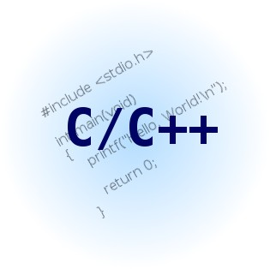
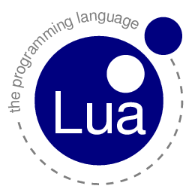


Current woes and PyPy’s goal
Problem
Creating interpreter requires a lot of work
For performance!
Language-based programming
PyPy’s goal
To be able to create interpreter easily
With high-level language like Python
Without giving up performance

Slide 8

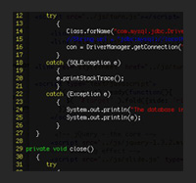
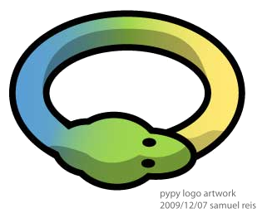
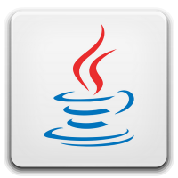
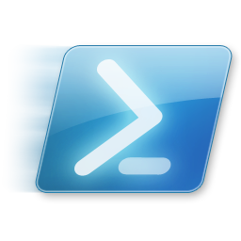
Principle what PyPy do
Toolkit to translate interpreter written in RPython to other backends(C/CLI/Java..)
C (native)
Java
Implementer
Interpreter code
Written in RPython
PyPy
CLI

Slide 9
What is RPython?
It is abbreviate for Restricted subset of Python
( Original Python : too dynamic to translate )
Only single inheritance is allowed
“For loop” only supports built-in type
Generator is supported, but exact scope is very limited
Dynamic dispatch to class is not supported
These are required to static analysis
(it is for

Slide 10
Templates
Problem
Problem

